Slide 1


Bengaluru Transport
Mobility & Equality Analysis
Milestone 4

Slide 2




Bengaluru Transport Analysis
Introduction
Urban transport mobility refers to the ease with which residents can access jobs, services, and opportunities through available transportation networks. In rapidly growing cities like Bengaluru, unequal access to public transit creates significant social and economic disparities. This study examines mobility patterns, infrastructure gaps, and accessibility challenges to support the development of equitable, data-driven urban transport solutions.

Slide 3


Bengaluru Transport Mobility & Equality Analysis
Problem Statement
Bengaluru's rapid urban growth has created deep disparities in transportation access. Low-income neighborhoods, outer peripheries, and underserved communities face inadequate public transit, long commute times, and limited last-mile connectivity — widening the mobility gap across demographic groups.

Slide 4


Bengaluru Transport Analysis
Research
Objectives
  Analyze mobility patterns across Bengaluru's transport corridors.
  Assess accessibility metrics for underserved communities.
  Evaluate transport demand distribution by area and group.
  Identify equality gaps in public transit coverage.

Slide 5


Bengaluru Transport Mobility & Equality Analysis
Dataset
Sources &
Structure
Key datasets include BMTC transport infrastructure records, BBMP demographic census data, mobility survey responses, and geospatial mapping layers. Data spans route coverage, ridership frequency, population density, and accessibility indices across Bengaluru zones.

Slide 6

Bengaluru Transport Mobility & Equality Analysis
Data Preparation
Raw datasets underwent multi-stage processing: missing value imputation, outlier removal, and standardization of transport records. Transformation pipelines integrated transit, demographic, and mobility data into a unified schema. Validation checks ensured consistency, completeness, and accuracy across all merged data sources.

Slide 7
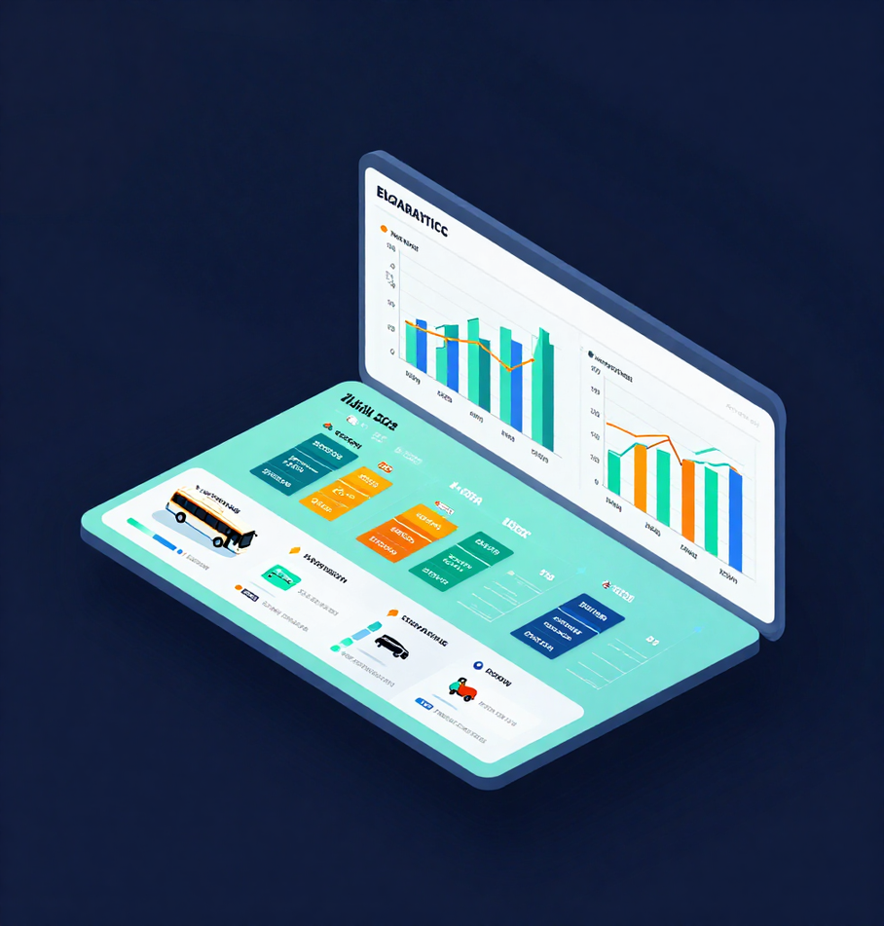
Thynk Unlimited
Mobility Analysis
Comparative analysis of transport usage across different areas, income groups, and demographic segments in Bengaluru. Patterns reveal significant variation in modal share, frequency of use, and commute distances between urban, peri-urban, and rural zones.

Slide 8

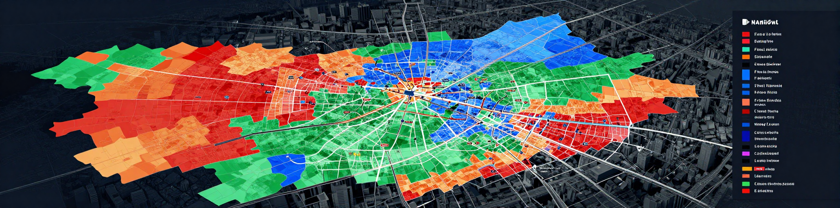
Thynk Unlimited
Accessibility & Equality Analysis
Spatial mapping reveals significant mobility gaps across Bengaluru's zones. Low-income and peripheral areas show limited transit access, fewer stops, and longer travel times. Equity indicators highlight underserved communities lacking adequate public transport coverage, underscoring the need for inclusive infrastructure planning.

Slide 9
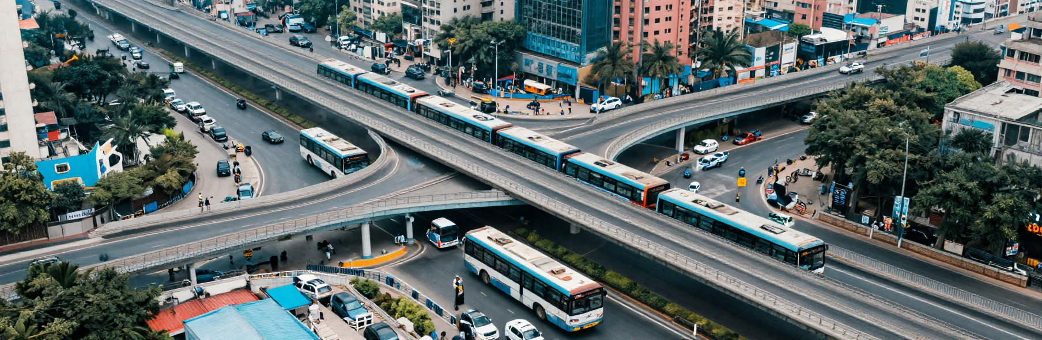
Thynk Unlimited
Key Insights
Peak demand concentrated in Whitefield, Electronic City & MG Road corridors. Over 62% of underserved zones lack last-mile connectivity. BMTC ridership gaps identified in 14 low-income wards. Metro usage skewed toward high-income areas, revealing critical mobility inequality across Bengaluru.

